Slide 1
Graph Analytics Using GraphFrames and GraphX

Slide 2
Spark

Slide 3
Graphs
Graphs “also called networks” are ubiquitous for web applications (and other use cases as well)
Consists of nodes and edges
Node (or vertex) is an object
Edge is relation between any two objects
Could be directed or undirected
Eg. Facebook network, LinkedIn, IOT – Graph of Graphs
Why graphs?
Powerful and concise way to explore semantic relationships between entities
Allows us to see how communities evolve (topology analysis)

Slide 4
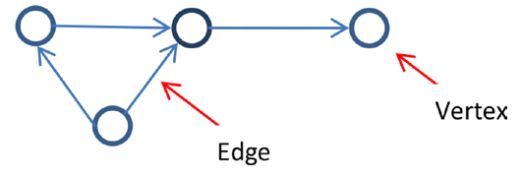
Terminology

Slide 5
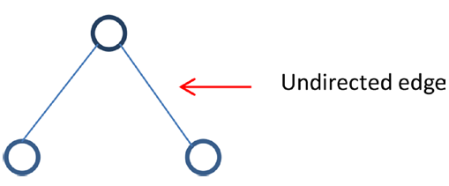
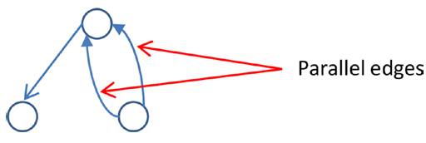
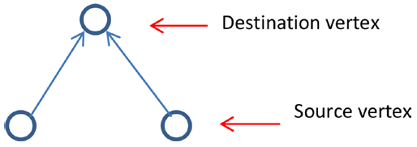

Slide 6
Graphs
Hmm…seems a lot like RDBMS
Both are highly structured
Data generally stored as collection of rows
But there is a huge difference
An edge in graph is a relationship that directly relates data items
It implies data is linked together directly
RDBMS on the other hand store links between data as tables.
Implies lots of joins to combine everything together
Makes retrieval of complex hierarchies a pain
Eg. Who are the most influential people in your circle?
RDBMS not always efficient

Slide 7
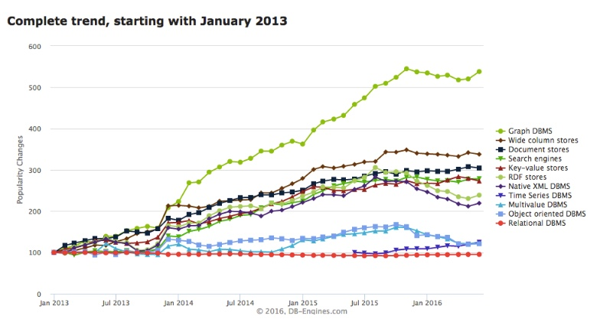
Popularity of graph analytics

Slide 8
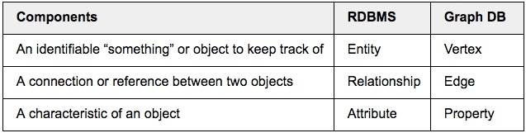
Graphs vs RDBMS
Primary purpose of Graphs (DB and analytics) is to store and manage “highly connected and complex data”
Efficient at handling high number of relationships between entities (data elements)

Slide 9
Graphs vs RDBMS
Graphs can essentially be thought of as next generation relational databases
Eliminated need of costly joins
Since relationships are now stored as edges
As complexity of query increases, it becomes extremely costly

Slide 10
Example
That movie about robots with the actor who was in that movie with that other actor that played the lead in Sivaji
RDBMS approach:
Find actors in Sivaji
Find all movies they were in
Find all actors in all of those movies who were not the lead in Sivaji
Find all movies they were in
Filter the list to those descriptions containing robot
Graph approach:
Walk from Sivaji to Thalaiva (Rajnikanth)
Links to movies he has been in
Links out of those movies to other actors
Follow back to list of movies and filter by robots
All of this is accomplished in one query without joins!!!

Slide 11
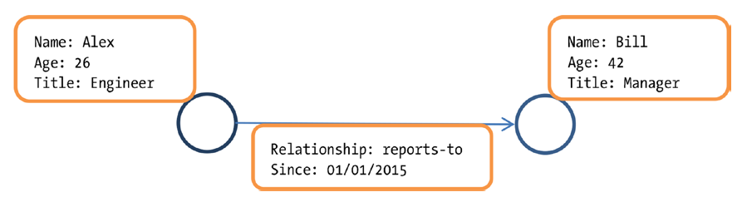
Property Graph

Slide 12
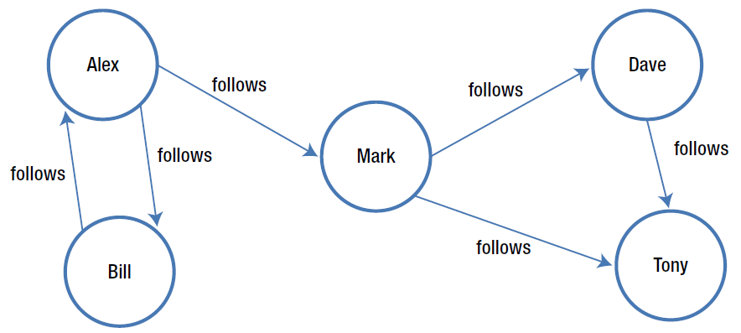

Slide 13
Introduction to GraphX
Earliest API to do graph processing in Spark
General purpose graph processing library
Collection of functions (also known as operators)
Fundamental graph operators
Advanced Operators
Page rank
Triangle count
Integrated platform for complete graph analytics
Optimized for fast distributed computing

Slide 14
API
Data types for representing graph oriented data
Operators for graph analytics
Data abstraction
Vertex RDD
Edge
EdgeRDD
EdgeTriplet
Graph

Slide 15
Data Types
Vertex RDD
Distributed collection of vertices
One entry for each vertex
Vertex represented by a key-value pair
Edge
Abstracts a directed edge
Source vertex id, destination vertex id, edge attributes
EdgeRDD
Distributed collection of edges
Graph
Abstraction for property graphs
Immutable, distributed, fault tolerant

Slide 16
Graph Analytics Pipeline
Read raw data
Preprocess
Extract vertices and edges and create property graph
Slice
Graph Algorithms
Analyze results

Slide 17
Issues with GraphX
No Java, Python API
Stuck with Scala
RDD based API
Doesn’t leverage more advanced Spark techniques
Query optimizer
Memory management

Slide 18
Introducing GraphFrames
DataFrame based graphs
Simplify querying
Motif based finding (great for structural patterns)
Query optimizations (as now we are leveraging DataFrames)
Remember, graphs are highly structured data

Slide 19
Example

Slide 20
GraphFrame

Slide 21
GraphFrames Vs GraphX

Slide 22
Workflow using GraphFrames
Load data as DataFrames (from a CSV file or any other type of file)
One DataFrame for vertices
One DataFrame for edges
Import GraphFrame package
Create GraphFrame (Graph essentially) from above two dataframes
Graph1 = GraphFrame(vertexDF, edgeDF)
Voila, start querying

Slide 23
Querying
Three types
Simple Queries
Motif
Graph Algorithms

Slide 24
Example
Let us understand this with help of an example
A handy one would be flight data
CSV file
Each row contains info about a particular flight
Eg. Source, destination, date, departure, arrival, late?, carrier etc
We can start asking questions here

Slide 25
Simple Queries
SQL queries on vertices & edges
E.g., what trips are most likely to have significant delays?
SQL query?
Graph queries
Vertex degrees
Edges per vertex (incoming, outgoing, total)
SQL query?
Triplets
Join vertices and edges to get (src, edge, dst)

Slide 26
Let’s dig deeper
How about finding all one hop flights from a carrier from Delhi to Mumbai, but there should be no direct connection between Mumbai to Delhi?
SQL query?
Let us assume flights to London are very delayed. They are all one hop flights with the hop being Mumbai. Heathrow suspects that Mumbai is the culprit. How can we figure out if Mumbai is to be blamed?

Slide 27
Motif

Slide 28
Motif

Slide 29
Motif

Slide 30
Motif

Slide 31
Motif

Slide 32
Graph Algorithms
PageRank
Find important vertices (Influential connections or hubs)
BFS, Shortest paths
Find paths between sets of vertices
Label propagation
Communities
Groups of vertices
Many others
Algos mostly wrapper to GraphX
Some are implemented using DataFrames

Slide 33
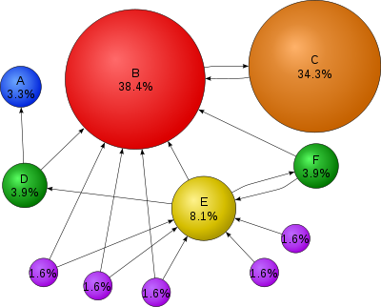
PageRank

Slide 34
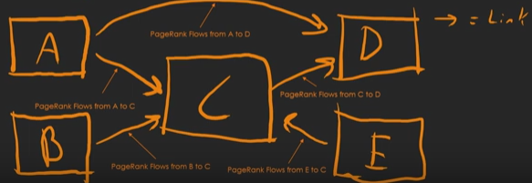
PageRank

Slide 35
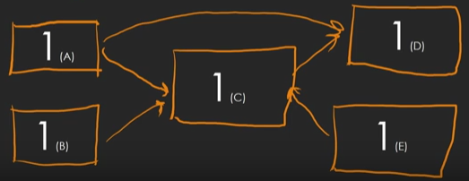
PageRank

Slide 36
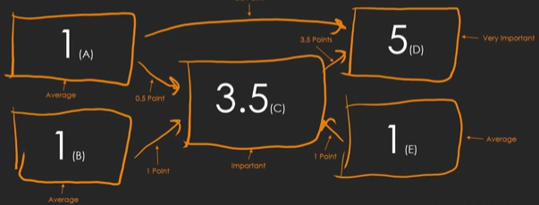
PageRank

Slide 37
Save and Load
Save & load the DataFrames.
vertices = sqlContext.read.parquet(...)
edges = sqlContext.read.parquet(...)
g = GraphFrame(vertices, edges)
g.vertices.write.parquet(...)
g.edges.write.parquet(...)

Slide 38
Creating a Graph
Let us imitate social network graph
Vertex represents user
Directed edge represents follow relationship

Slide 39
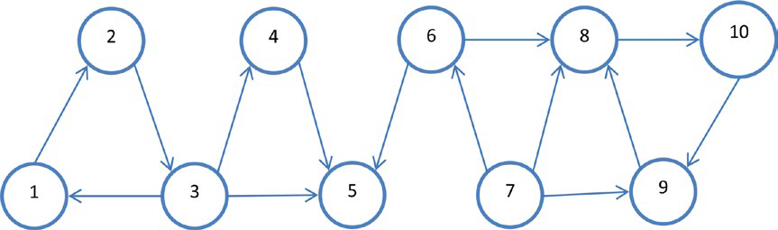

Slide 40
Hands On
Let us now move on to hands on
We will first imitate a social network
After that, we will move to an airline case study

